Slide 1
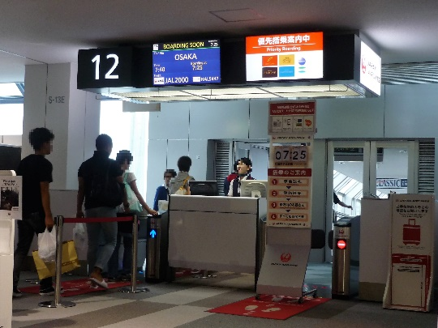
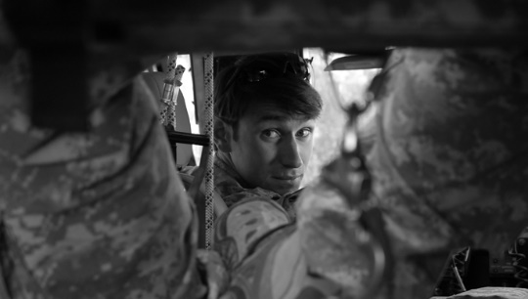
Good Leaders make others feel safe
Leadership is an activity in which conditions are created in which everyone can do their most courageous thinking together.
Trending
What is safety?
Trust is a feeling
When we feel safe there is trust and cooperation
It is the leader that sets the tone
I cant simply say to someone to trust me and you will
Create a word bank for discussion
We spend time and energy to protect ourselves from each other
Sacrificing others is what offends most people
How do you create a safe environment?
Lifetime Employment?
Head counts V Heart Counts
Leadership is a choice, it is not a rank
It is better that we should all suffer a little than any of us should have to suffer a lot
What makes a great parent?
What organisation do you want to work in?
Choose to look after the person to the left of you and choose to look after the person to the right of you
Christopher Bauman – www.chrisbauman.com.au

Slide 2
1. What are the characteristics of Captain Swenson?
____________________________________________________________________________________________?
Advanced Question Words
2. Where do people like Captain Swenson come from? ___________________________________________________________________________________________ ?
GoPro
RISK?
Trust
Dead End
3. Sacrifice yourself so others may gain (Vs) Sacrificing others so that you may gain ___________________________________________________________________________________________ ?
Layoffs
4 If you get the environment right, every one of us has the capacity to do remarkable things ___________________________________________________________________________________________ ?
What organisations don’t fear their leaders
5. Put yourself at risk to save others ___________________________________________________________________________________________ ?
Cooperation
Out in theatre
6. What can you achieve by working together instead of against one another? ___________________________________________________________________________________________ ?
Because they would have done it for me
Commissioned
7. What are some uncertainties in life that you have to deal with? ___________________________________________________________________________________________ ?
8. Never sacrifice the people to save the numbers, instead sacrifice the numbers to save the people __________________________________________________________________________________ ?
The reading, the mind and the eye test
If someone has constantly sacrificed others, is it possible for them to change and how can those that they have sacrificed trust them?
Christopher Bauman – www.chrisbauman.com.au

